Slide 2
Bayesian Networks
Recall the product rule P(X,Y) = P(X|Y)P(Y)
Why is this useful and desirable?

Slide 3
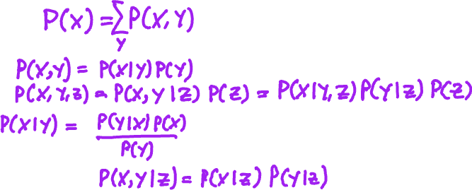
Bayesian Networks
Recall some basic notions from our revision of probability
The Sum Rule
Product Rule
Bayes Rule
Conditional independence
What can we do with these concepts?

Slide 4
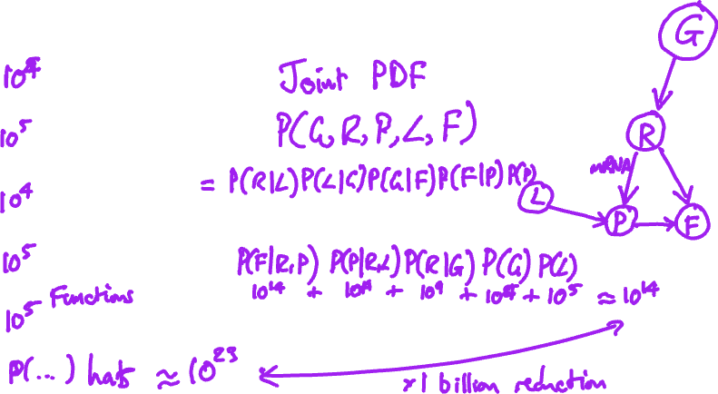
An Example
In biology, Function F is controlled by:
Genes G
RNA R
Proteins P
Ligands L
Can we draw a diagram of the relations?

Slide 5
What does this have to do with Probability?
Product rule permits the Joint Distribution to be factorized
Why is this useful?

Slide 6
Benefits of Factorisation
Reduced number of parameters
Univariate conditional PDFs much easier to measure/estimate
Explicitly models causal structure
Models with this structure are called Bayesian Networks

Slide 7
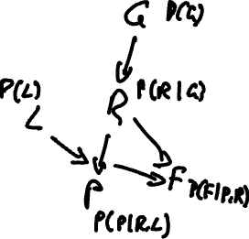
Formal Definition
Graphical representation of factorised distribution
Directed graph
Each node corresponds to a single variable
Edges between node represents conditional relationships
Each node has associated condition probability distribution
Strictly acyclic – a directed acyclic graph (DAG)

Slide 8
Constructing a DAG
Choose the variables needed to model the domain and order them. A good order has causes preceding effects and this will lead for a more compact representation.
For each node, choose a set of parents such that the chain rule is satisfied and that the parents can plausibly represent causes of the node's effect.
Add edges directed from parents to the node.
Write down a conditional probability table for the node.

Slide 9
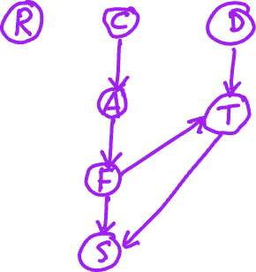
Another Example
You are cooking C in your kitchen.
It is raining R outside
The neighbour's dog D is loose.
You accidently A set fire to a pan of oil.
The fire spreads and soon the house is on fire F.
You call the fire service S who come and douse the fire.
Whilst the fire service are there, they rescue your cat, which is stuck up a tree T.

Slide 10
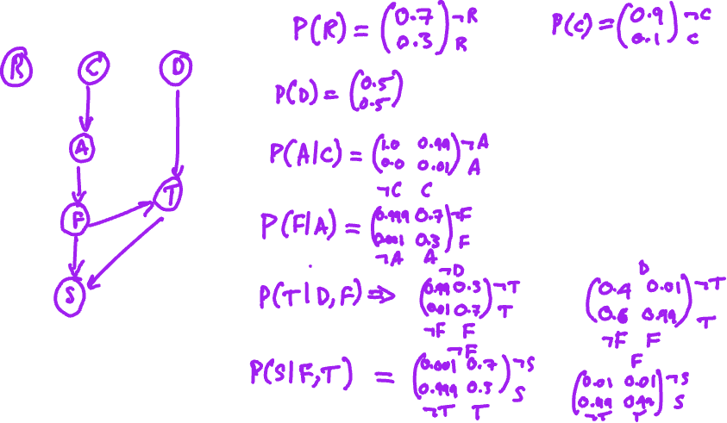
Example

Slide 11
Exercise 15: Bayesian Networks

Slide 12
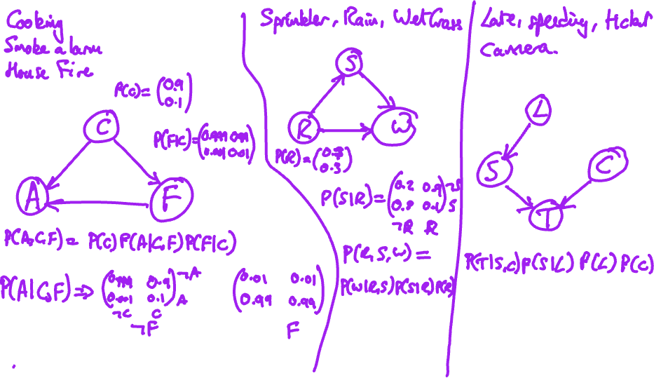

Slide 13
Inference in Bayesian Networks
Once we have a Bayesian network, what can we do?
Network represents the joint distribution
So we can do anything that we can do with the joint distribution
Can compute the joint distribution and derive quantities from that
But that is wasteful and negates the advantages of the network
Can we compute directly?

Slide 14
Inference in Bayesian Networks
Open notebook
9. Exact Inference in Bayesian Networks nocode.ipynb

Slide 15
Exercises 16

Slide 16
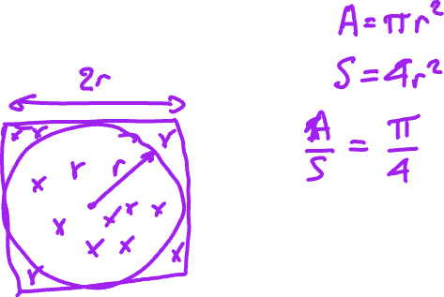

Approximate Inference

